Slide 1

Zero to Testing in JavaScript
Basics of testing, in JS

Slide 2

About me
Blog: thewebivore.com
Twitter: @pamasaur
Co-organizer of Philadelphia JavaScript Developers
Podcasting on Turing Incomplete (@turingcool)
Testing fanatic

Slide 3
Welcome to the testing track?

Slide 4
*pause* … A TESTING TRACK!

Slide 5
Let’s kick this off right!

Slide 6
Agenda
My testing story
Testing theory
Basic test walk-through
Testing frameworks
Other forms of testing
Working testing into your workflow
Minishop (workshop)

Slide 7
My testing story

Slide 8
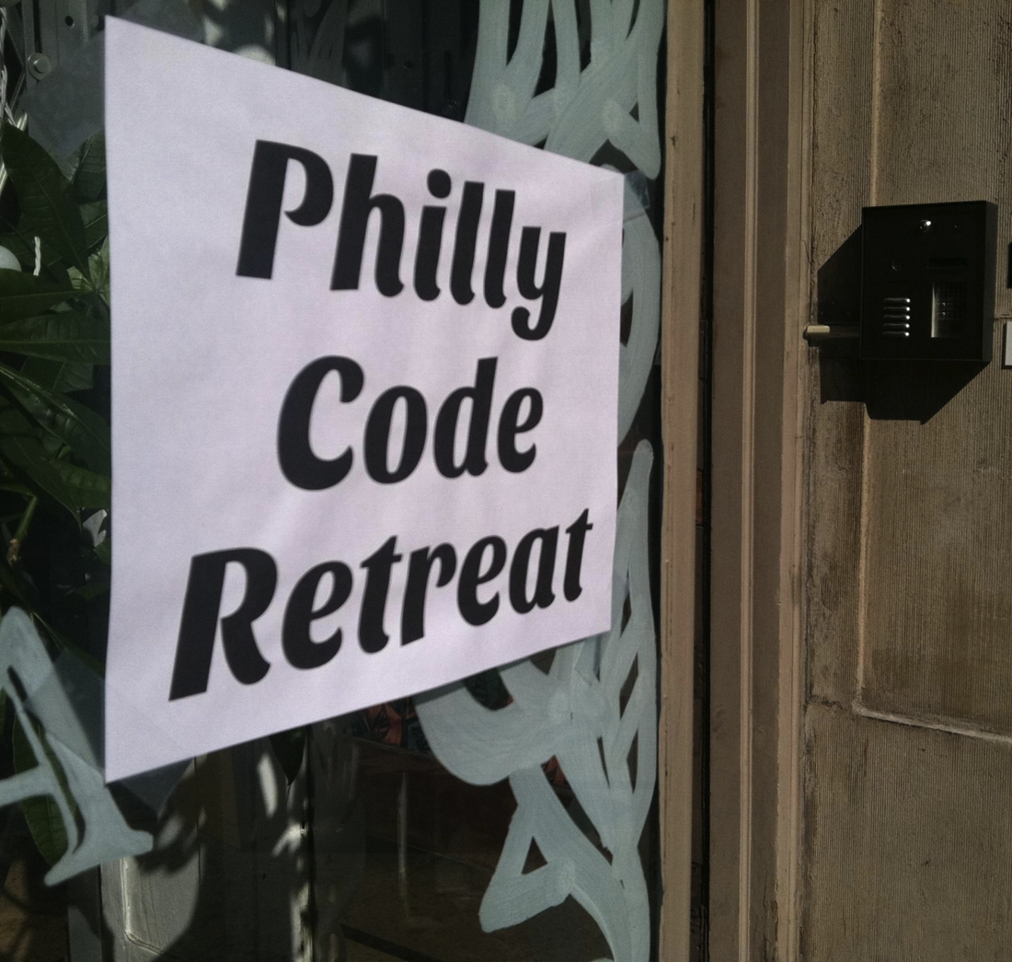
When I first started writing tests
Code Retreat
TDD
Pairing
Throw-away code
Notes:
And I organized Code Retreat! ;)

Slide 9
What about tests in my projects?

Slide 10
previously:
“Tests* are doing the dishes”
* and writing docs and fixing bad code

Slide 11
aka:
“Tests are work for people you don’t like”

Slide 12
The other piece that I would add to this is, and I’ve said this before at talks, that testing isn’t something that you do because it is good to be testing. It’s not your lettuce. You do it because it increases your confidence in your code. And it increases your ability to release quickly and make changes without worrying that something is going to break. And so, if you’re paranoid like me, that’s a good incentive to do testing. And if you have a whole lot of self-confidence, maybe you’re just a really great coder. But maybe it’s a little bit more likely that you’re going to make mistakes and you might pay for it a little bit later.
Julie Ralph, Protractor
http://javascriptjabber.com/106-jsj-protractor-with-julie-ralph/

Slide 13
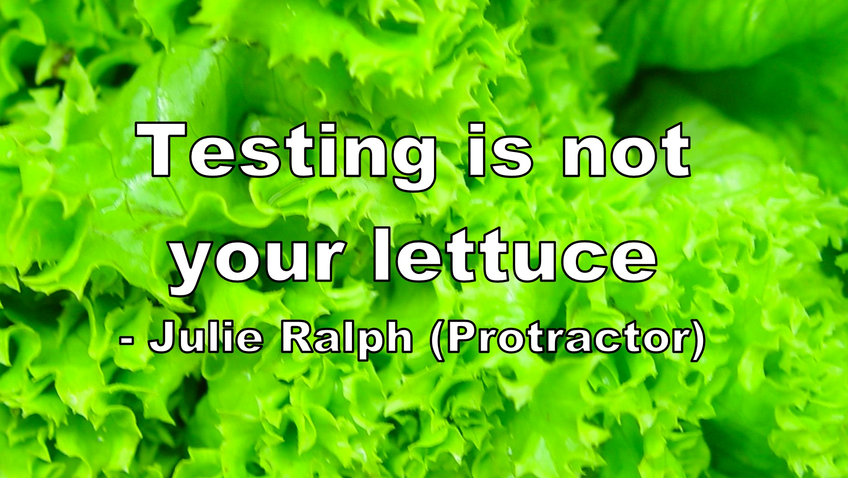

Slide 14
now:
GOOD developers write tests

Slide 15
Literally.

Slide 16
-b for bad coder

Slide 17
What do you call code without tests?
Legacy code.

Slide 18
Testing basics
When you break it, it breaks!
Secondary line of documentation defense
Design tool
Notes:
How many of you have written a test? Ever? Design tool is debatable, and I’ll touch on TDD/BDD

Slide 19
When you break it, it breaks!
Testing is required to enable refactoring
Regularly run tests
Use test results to make decisions

Slide 20
Documentation defense
Tests describe behavior
Read tests to understand behavior
Write tests to describe behavior
Write tests to validate behavior

Slide 21
Tests as design tool
Tests describe functionality
Write functionality description (test)
Write code to make it work

Slide 22
BDD/TDD
Behavior Driven Development
Test-Driven Development
“Write tests to inform how you write your code”

Slide 23
BDD
describe
it
before
after
beforeEach
afterEach

Slide 24
TDD
suite
test
setup
teardown

Slide 25
Test Ever vs. Test Never

Slide 26
Types of testing
Unit
Integration
Functional
E2E

Slide 27
Unit
Testing functionality in isolation
“When I call addNumbers, it returns the value of the added numbers”

Slide 28
Unit testing takeaway:
Test your code
Notes:
Test code YOU wrote … you should use well tested frameworks

Slide 29
How to only test your code?
Isolate
Faking

Slide 30
Fake things: Spies, stubs, and mocks
Spy: an object that records its interactions
Stubs: fake objects
Mocks: fake objects with expected behavior
Generally, you can SPY on a function, STUB an object, and MOCK a service.

Slide 31
Integration
Multiple pieces of code together
“Is the router setting up my models correctly?”

Slide 32
Functional
Does your code work as product expects it to? (functional requirements)
“When I click the login button, it should log me in”

Slide 33
E2E (end-to-end)
Functional, but fully integrated with external services, simulate real-time situations.
“When I click ‘Login with Google,’ it logs me in”

Slide 34
JavaScript test walk-through

Slide 35
JavaScript test walk-through
Setting up your base
Writing the test/expectations*
Making it pass*
* The order of these is debatable

Slide 36
Jasmine
jasmine.github.io
Download a standalone version on GitHub from pivotal/jasmine
Node: jasmine-node (fork of karma-jasmine)
Notes:
I’ll go into these tools more in depth after we write our test, but I wanted to touch on the two I’ll show. BDD style

Slide 37
Mocha
visionmedia.github.io/mocha
Node!
npm install –g mocha
Notes:
More on them later

Slide 38
Anatomy of a test
Describe [thing you’re testing]
It [does something you expect it to do]
Rinse and repeat.

Slide 39
Example test walk-through
with Mocha

Slide 40
var assert = require('assert');
describe("An area of my application", function() {
it("should know that 2 and 2 is 4", function(){
assert.equal(4, 2+2);
});
});
Notes:
This is the whole test, and we’ll walk through it piece by piece

Slide 41
var assert = require('assert');
describe("An area of my application", function() {
it("should know that 2 and 2 is 4", function(){
assert.equal(4, 2+2);
});
});
Notes:
Require your necessary libs
Node/browserify require system

Slide 42
var assert = require('assert');
describe("An area of my application", function() {
it("should know that 2 and 2 is 4", function(){
assert.equal(4, 2+2);
});
});
Notes:
Use your words! BDD = “the video player” TDD = “VideoPlayer”

Slide 43
var assert = require('assert');
describe("An area of my application", function() {
it("should know that 2 and 2 is 4", function(){
assert.equal(4, 2+2);
});
});
Notes:
Just javascript functions.

Slide 44
var assert = require('assert');
describe("An area of my application", function() {
it("should know that 2 and 2 is 4", function(){
assert.equal(2+2, 4);
});
});
Notes:
Make an assertion or expectation
Assert and expect are about the same. Assert is more like (this, that), expect is a sentence (BDD)

Slide 45
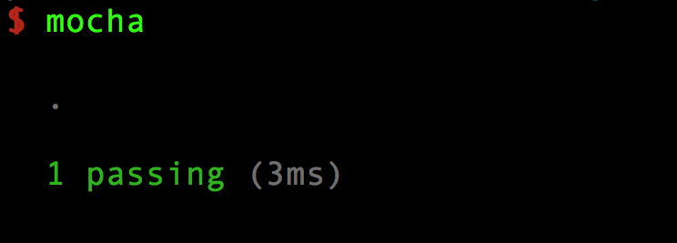
Notes:
BOOM

Slide 46
Testing Tools

Slide 47
Test describers
Jasmine
Mocha
QUnit
node-tap
YUI Test
Notes:
I like Jasmine. Mocha is nice for a greenfield project/for immediate CLI integration, and it also lets you choose your assertion library.
JSUnit is no longer actively supported or maintained, but it's kind of the OG of JS unit testing.

Slide 48
Assertions
Chai
should.js
Expect.js
better-assert
Notes:
People have preferences on these ... I'm somewhat ambivalent, as the words (expect, assert, should) are often used interchangeably and have more to do with your style (BDD/TDD) which doesn't matter if you aren't testing yet.

Slide 49
Spies, stubs, and mocks
Sinon.js
Jest from Facebook
Notes:
Jasmine has its own spies, as do other test frameworks; Sinon is nice if you run into the limitations of those frameworks, and it does awesome things for mocking large libraries

Slide 50
Test runners
Karma
Testem
YUI Yeti
Notes:
Jasmine also has a test runner - a lot of these things cross categories, and it's a little difficult to understand where each piece fits.

Slide 51
Bringing testing into the fold
3 tips for making testing a regular part of your world

Slide 52
#1: Teach testing
Attend talks like this!
Practice (ex. Code Retreat)
Pair programming

Slide 53
#2: Code coverage
Istanbul
Blanket.js
Notes:
Fascinating data, and can help you monitor code quality over time

Slide 54
#3: Code review
Quality assurance
Mentoring
Don’t accept without tests!
Notes:
Code review is great for 1m reasons, and enforcing testing is just one of them

Slide 55
What’d we learn?
Basics of testing
Writing a JavaScript test
Tools in JavaScript for testing
Ways to create a testing culture

Slide 56
Minishop
(workshop, playshop …)

Slide 57
TODO
Set up karma (our test runner)
With Jasmine (our assertion framework)

Slide 58
TODO
Write a failing test
Correct the failing test

Slide 59
TODO
Write another test
Setup in beforeEach

Slide 60
Thank you!
Find me online at
@pamasaur
thewebivore.com (blog)
turing.cool (podcast)
thewebivore.com/book (book!)

